Slide 1

Establishing a Positive
Board Culture
Virtual Professional Development Series 2024/2025
November 5, 2024
Presented by:
Angela L. Irwin, Owner
AirWin Educational Services, LLC

Slide 2
Board Culture - Defined
Set of traditions and habits established over time that guide behavior – written and unwritten rules that influence relationships between board members . . .
BOARD DYNAMICS

Slide 3

“Board culture has a significant influence on the way your board carries out its work and shapes your board performance.”
Board Source

Slide 4

Characteristics of a Positive Board Culture
Healthy and respectful relationships between and among all stakeholders
Trusting and candid interactions
Commitment to vision and mission
Holding each other accountable – a governance system of accountability

Slide 5
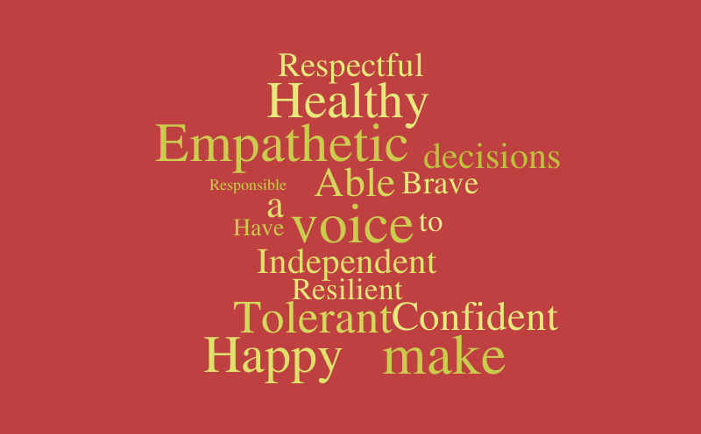
Healthy and Respectful Relationships
Open, honest and transparent communication(s)
Willingness to foster relationships
Building a culture of teamwork and support
Effective conflict resolution

Slide 6

Trust and Candor
Consistency in decision-making
Creating a “safe” environment
Ensuring information sharing openly and transparently
Admitting mistakes
Investing time

Slide 7

Vision and Mission Commitment
Encouraging vision/mission-driven decision-making
Ensuring understanding of vision and mission
Measuring vision/mission fulfillment
Aligning goals with vision/mission

Slide 8
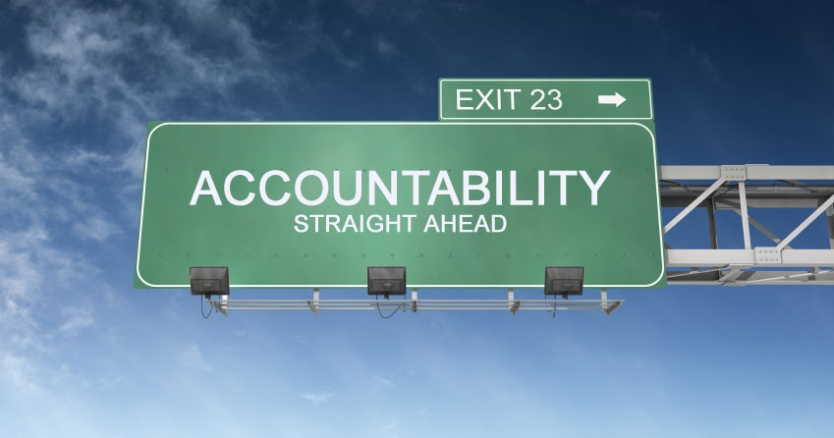
System of Accountability
Articulate clear governance expectations
Adopting ethical standards or codes of conduct
Ongoing professional development
Self-evaluate

Slide 9
Positive Board Culture
“Board culture has a significant influence on the way your board carries out its work and shapes your board performance.”
Board Source

Slide 10

THANK YOU!
4521 Henry Drive
Beaverton, MI 48612
989.239.7555
ANGELA@AIRWINLLC.COM

